Slide 1

Convention on Access to Information, Public Participation in Decision-making and Access to Justice in Environmental Matters
(Aarhus Convention)
Experiences with a regional instrument in the ECE region
Theodore Koukis
UNECE Aarhus Convention Secretariat
Port of Spain
17 September 2013

Slide 2
The Aarhus Convention
The only international legally binding instrument (along with its Protocol on PRTRs) enshrining Principle 10 of the Rio Declaration

Slide 3
Aarhus Convention
Water Management
Nuclear Energy
Development and Poverty
The Green Economy
Human Rights
Fighting Corruption

Slide 4
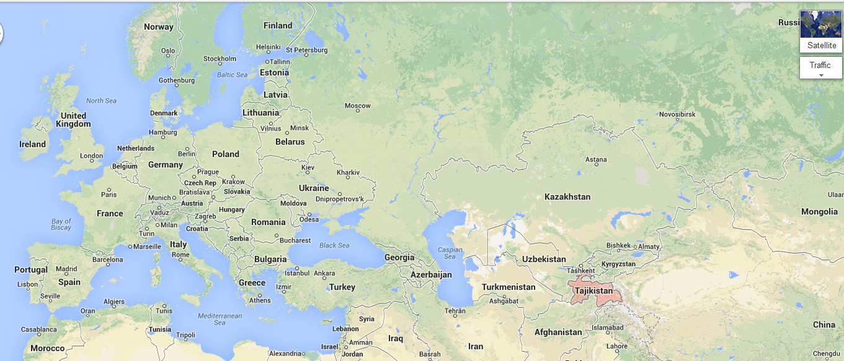
UNECE Region and beyond

Slide 5
Aarhus Convention structure
Meeting of the Parties
(every three years)
Working Group of the Parties
(every year)
Task Force on Access to Information
Task Force on Public Participation in Decision-making
Task Force on Access to Justice
Compliance Committee
Secretariat
(supports all work, including capacity building)
Bureau

Slide 6
Access to Information
Raise awareness among the public about their rights
Framework
Task Force on Access to Information
(2nd meeting – Geneva, 16-17 December 2013)
Specific tools
Recommendations on the more effective use of EIT
(Decision II/3)
Draft Guidance for National Nodes for Clearinghouse mechanism
Promote the accessibility of information held by the private sector and by other bodies than environmental authorities
Facilitate the dissemination of the priority types of information
Questionnaire on their implementation (to be disseminated)
Improve access to environment-related health information

Slide 7
Public Participation in Decision-making
Capacity-building (training) activities to ensure effective public participation in decision-making with regard to:
Framework
Task Force on Public Participation in Decision-making
Specific tools
The Aarhus Convention’s draft Recommendations on Public Participation in Decision-making in Environmental Matters (
Case studies (request for submission)
Assist public authorities in carrying out public participation procedures under the Convention
disseminate notice of the public participation procedure
organize public hearings
Draft legislation, regulations and other generally applicable legally binding normative instruments
Plans , programmes and strategies
Projects

Slide 8
Public Participation in decision-making on GMOs
Raise awareness among the public about their rights under the Convention to participate in GMO decision-making
Framework
Working Group of the Parties
Specific tools
Lucca Guidelines on access to information, public participation and access to justice with respect to genetically modified organisms
GMO amendment to the Convention
Provide capacity-building/training to government officials about how to ensure effective public participation in this area
Round table on GMOs under the Aarhus Convention
(Geneva, 16-17 October 2013)
Assist in preparing required documents for ratification of the GMO amendment

Slide 9

Public Participation in international forums
Focus area
Assist the Government to more effectively promote the public’s input to the Government's position to international forums
Assist in developing the national action plan on PPIF
Framework
Working Group of the Parties
(15th and 16th meeting)
Specific tools
List of international forums (in Eng, Fre and Rus)
Monitor review of policies and strategies by international financial institutions
Draft checklist of measures to be borne in mind when developing national action plans on PPIF (in Eng)
3-minute survey (in Eng)
Compendium of the case studies (in Eng)
Almaty Guidelines promoting the application of the principles of the Convention in international forums

Slide 10
Success stories @ ECE region
Germany: Environmental Information Portal www.portalu.de
Hungary: Public Participation river basin management planning process
Kyrgyzstan: public hearings for gold mining
Georgia: public participation required for permits
Establishment of Aarhus Centres (with the support of the OSCE)

Slide 11
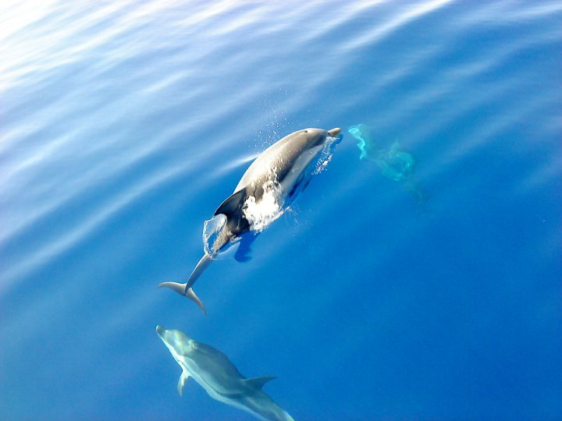
Public participation good practice

Slide 12
Access to Justice
Promote a multi-stakeholder dialogue at the national level
Engage bar associations, public interest lawyers, law schools and judicial training institutions in capacity-building activities
Framework
Task Force on Access to Justice
(7th meeting – Geneva, 3-4 March 2014)
Specific tools
Analytical studies
Database of case law related to the Convention
Substantive focus: standing, remedies and costs

Slide 13
Aarhus tool box
National Implementation Reports
Aarhus Convention Implementation Guide
(second edition 2013)
Compliance Committee findings and Recommendations
Surveys
Online Compendium on best practices
Guidance Material
Training Workshops (senior judges
Advisory Missions
Aarhus Clearinghouse
PRTR.net

Slide 14
Compliance with the Convention
Focus area
Raise awareness and capacity among respective public authorities with respect to Committee’s findings and recommendations
Framework
Meeting of the Parties (MoP)
Specific tools
MoP decisions on non-compliance
Translate findings of the Compliance Committee into the national language and post on the websites
Compliance Committee Findings and Recommendations
Case law of the Compliance Committee (publication of the European ECO Forum)
Compliance Committee
Assist in implementing related decisions, as appropriate
Guidance document on the Aarhus Convention Compliance Mechanism

Slide 15
Compliance Committee
Compliance Committee
Soft Mechanism
Not a tribunal
Non-confronta-tional
Does not impose sanctions

Slide 16
The Compliance Committee can be triggered in four ways:
A Party may make a submission about compliance by another Party.
A Party may make a submission concerning its own compliance.
A member of the public may make communications concerning a Party’s compliance with the Convention.
The Aarhus Convention secretariat may make a referral to the Committee.

Slide 17
Case study: Albania
Alliance for the Protection of the Vlora Gulf
Complaint: Establishment of major industrial and energy park
Compliance Committee
Meeting of the Parties
( MoP-3)
Decision on non-compliance
Compliance Committee and Albanian Authorities
Non-Compliance
Reason: Public had not been properly informed or consulted
Recommendations on improving compliance
Dialogue
Albania reported on measures taken to fulfil its obligations
Meeting of the Parties
(MoP4)
Albania
No longer
in a state of non-compliance

Slide 18
Road ahead
Meeting of the Parties to the Aarhus Convention
(Maastricht, 30 June-2 July 2014)
Meeting of the Parties to the Protocol on PRTRs
(Maastricht 2-4 July 2014)
Strategic Plan
Work Programme
National Implementation Reports

Slide 19

Thank you!
Contact: public.participation@unece.org
http://www.unece.org/env/pp/welcome

